Slide 1
Week 2 – Topics
Boolean Operators
Conditional Logic
if → else
if → else if → else
Switch
Loops
for Loop
while → Loop
do while → Loop
Branching
User Input

Slide 2
Boolean Operators

Slide 3
Boolean Operators
Using programming to automate tasks means the computer needs a way to make decisions.
Decisions require comparing and evaluating information available and then deciding which way to proceed.
Boolean values are essential in these comparisons. With each decision we need the computer to make, we eventually answer in a yes or no manner - in Java, that yes or no is represented by: true or false.
The Java Boolean operator is also a data type just like int, float, or char. It is used where the condition true or false is needed, where the answer needs to be either 1 or 0. 1 being true and 0 being false.
List of Boolean operators:
Operator | Meaning
< | Less than
> | Greater than
<= | Less than or equal to
>= | Greater than or equal to
== | Equal (type matters)
!= | Not Equal
Content Link in LMS

Slide 4
Conditional Logic

Slide 5
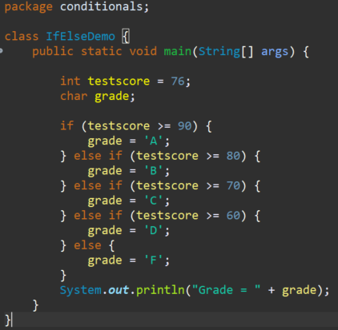
if → else Conditionals
if Statement
if (/*Boolean Expression - Conditional expression that results in a Boolean value*/) {
//code to run if Boolean expression in parentheses evaluates to true
}
if → else Statement
if (/*Boolean Expression #1*/) {
//code to run if Boolean expression #1 in parentheses evaluates to true
} else {
//code to run if Boolean expression #1 in parentheses evaluates to false
}
if → else if → else Statement
if (/*Boolean Expression #1*/) {
//code to run if Boolean expression #1 in parentheses evaluates to true
} else if (/*Boolean Expression #2*/) {
//code to run if Boolean expression #2 in parentheses evaluates to true
} else {
//code to run if Boolean expression #1 & #2 in parentheses evaluates to false
}

Slide 6
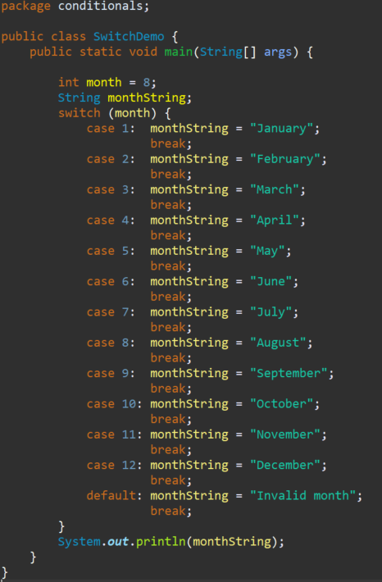
switch Statement
There is also another programming construct we can use to create logical paths with multiple options in a similar fashion.
This construct is called a switch statement and is used to evaluate a variable and then provide multiple different code blocks that could be executed based on the value of the variable.

Slide 7
Loops

Slide 8
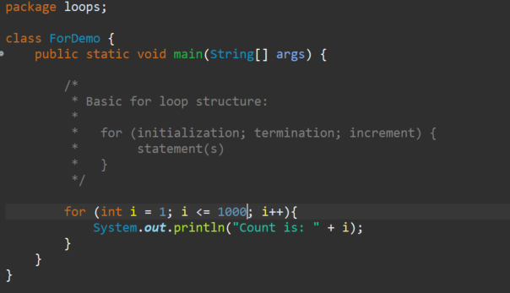
For → Loop
Content Link in LMS

Slide 9
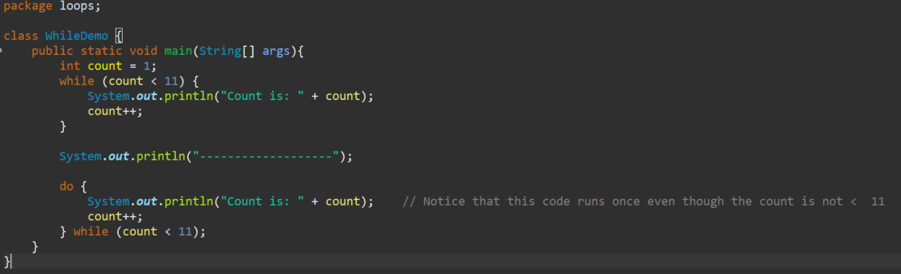
while → Loop and do while → Loop
Content Link in LMS

Slide 10
Branching

Slide 11
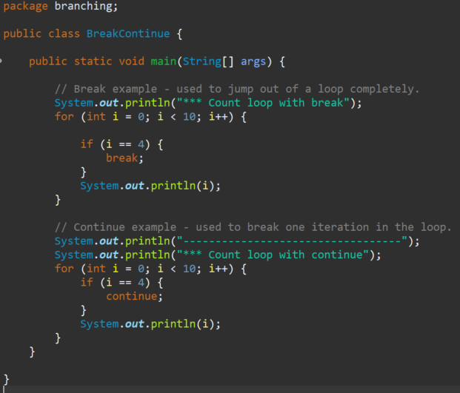
Branching - break vs. continue Statements
Branching statements allow the flow of execution to jump to a different part of the program
The common branching statements used within other control structures include:
break - used to break completely out of a loop
continue – used to break one iteration in a loop
return - exits from the current method, and control flow returns to where the method was invoked.
Content Link on Branching

Slide 12
User Input

Slide 13
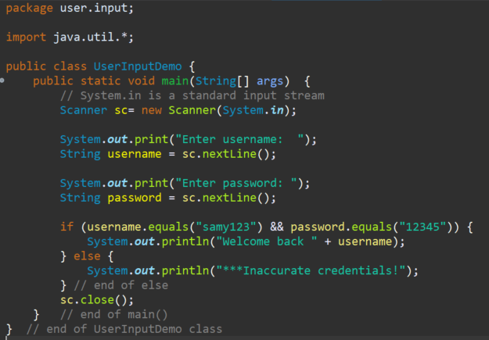
User Input
We need data to tell our programs to make decisions with; and up to this point, we've been hard coding data into variables to explore coding constructs.
However, the original source for most data is user input. In order to make decisions based on responses or data entered from a user, let's take a look at one way we can prompt a user to enter some data and then store the data in a variable to use in our code.
To receive user input in Java, we can use the Scanner object. It is in java.util package, so we need to import it.
** Note: this method of interacting with a user is a temporary method for the purpose of being able to receive user input and is not the recommended way in live, production code to interact with users. We will learn additional ways later on.
Content Link in LMS

Slide 14
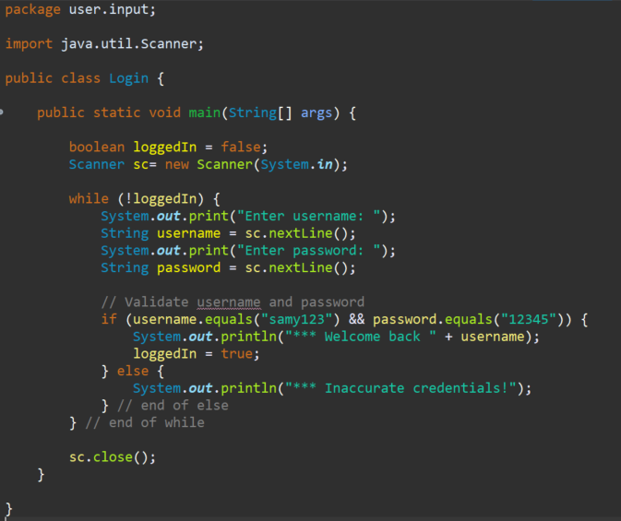
Coding Challenge
Try the coding challenge from the User Input page in the LMS
Take the login code example with while loop and enhance it
Add a login retry attempt count that would enable the user to only enter the incorrect credentials a certain number of times before displaying a message like "You are locked out!" and ending the loop.
https://github.com/ckiefriter1/Java-Code-Examples/blob/main/src/user/input/Login.java

Slide 15
Appendix

